Slide 1
Week 7: Understanding where to begin - Story Mapping

Slide 2
Agenda
Recap of last week’s session: Usability Testing
What are story maps?
Workshop: Let’s create a story map!

Slide 3
Recap of last week’s session
Usability Testing

Slide 4
Cognitive walkthrough helps us quickly identify the design’s usability for a new or infrequent user
Usability testing helps us test how the design address particular user needs
User acceptance testing helps us test clearly defined criteria to see whether a feature is complete

Slide 5
Story Maps

Slide 6
Story maps are a visual representation/map of the user’s action when interacting with your product
WHAT IS A STORY MAP

Slide 7
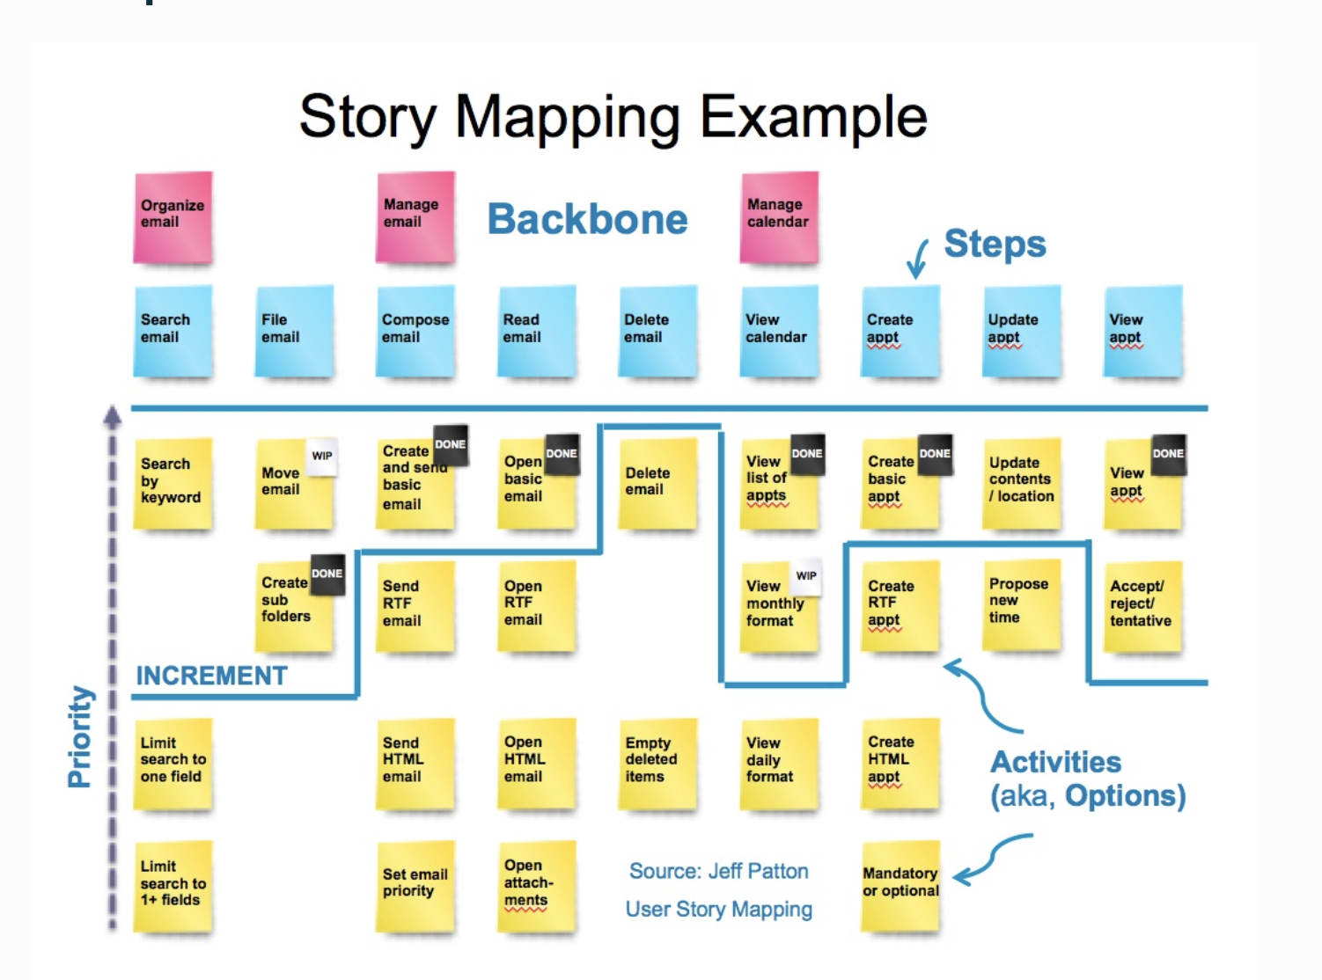
EXAMPLE

Slide 8
Story maps help to map the big picture and scope it down to narrow features and functionalities
WHY CREATE A STORY MAP

Slide 9
Story maps help you identify the most critical features and the corresponding users all in one place
WHY CREATE A STORY MAP

Slide 10
Help in identifying and tackling assumptions and risks that need to be validated and mitigated.
Story maps identify gaps in the process
WHY CREATE A STORY MAP

Slide 11
Story maps help you map and prioritize releases
WHY CREATE A STORY MAP

Slide 12
Story maps can help you loosely develop a roadmap
WHY CREATE A STORY MAP

Slide 13
Journey maps are meant for discovery and capturing user emotions when using your product
Story maps are meant to help with planning and implementation.
STORY MAP VS JOURNEY MAP

Slide 14
Let’s create a story map for CAMD Suite!

Slide 15
Thank you!

